Slide 1
MAIL-ORDER PHARMACY
Training Name
Trainer Name
Company Name

Slide 2
Index
Project Member details
Project Overview
Modules
Each API deails
Testing and Code coverage
Deployment
Project Output
Take aways
Conclusion

Slide 3
MEMBERS
Name Id
Haneesha 111111
Vinusha 222222
Anusha 333333

Slide 4
RESPONSIBILITIES
Haneesha : Authorization Micro service, UI and testing.
Vinusha : Drugs Micro service and it’s testing.
Anusha : Refill Micro service and it’s testing.
….

Slide 5
INTRODUCTION
Mail-order pharmacies operate through your health insurance plan and can be cheaper and more convenient than getting your medications from a local pharmacy.
A “mail-order” prescription means that you don’t have to pick up your medication from a pharmacy ,instead it is delivered to your doorstep.
There will be a member portal which is the developed part of this scope that consumes all the micro services.
The Portal allows its members to subscribe for drugs refill, allows to pay bills etc.

Slide 6
MODULES
Drug Module.
Subscription Module.
Refill Module.
Member Portal.

Slide 7
MICRO SERVICES

Slide 8
DRUG MICROSERVICE
SUBSCRIPTION MICROSERVICE
REFILL
MICROSERVICE
SearchDrugsByID
(int drugId)
SearchDrugsByName
(string drugName)
GetDispatchableDrugStock
( int drugId, string location)
GetSubscriptionDetails
(int id)
AddSubscription
(Subscription subscription)
RemoveSubscription
(int id)
GetAllSubscriptionDetails()
GetRefillStatus
(int subscriptionId)
GetRefillDueAsOfDate
(int subscriptionId, DateTime date)
AdhocRefill
(int subscriptionId, int policyId, int memberId, string location)
AddRefillStatus
(Subscription subscription)
AUTHORIZATION MICROSERVICE
TokenGeneration (string name,string password )

Slide 9
DRUGS
‘S’ includes ‘D’
SUBSCRIPTION
‘S’ includes ‘R’
‘R’ includes ‘D’
REFILL
‘R’ includes ‘S’
extends
extends
extends
AUTHORIZATION
MEMBER PORTAL
Subscription -‘S’
Drugs - ‘D’
Refill - ‘R’
INTERACT
MEMBER

Slide 10
Subscription Micro Service
Get the Prescription Details and Insurance Policy Details from Member Portal.
Scan the Drug Details and check its availability by interacting with Drugs Micro service.
View If there are any Re-fills with pending payment status.
CONTROLLER
DRUGS
MICROSERVICE
Calls
HELPER CLASS
Calls
SERVICE
REPOSITORY
Calls
Calls
REFILL
MICROSERVICE

Slide 11
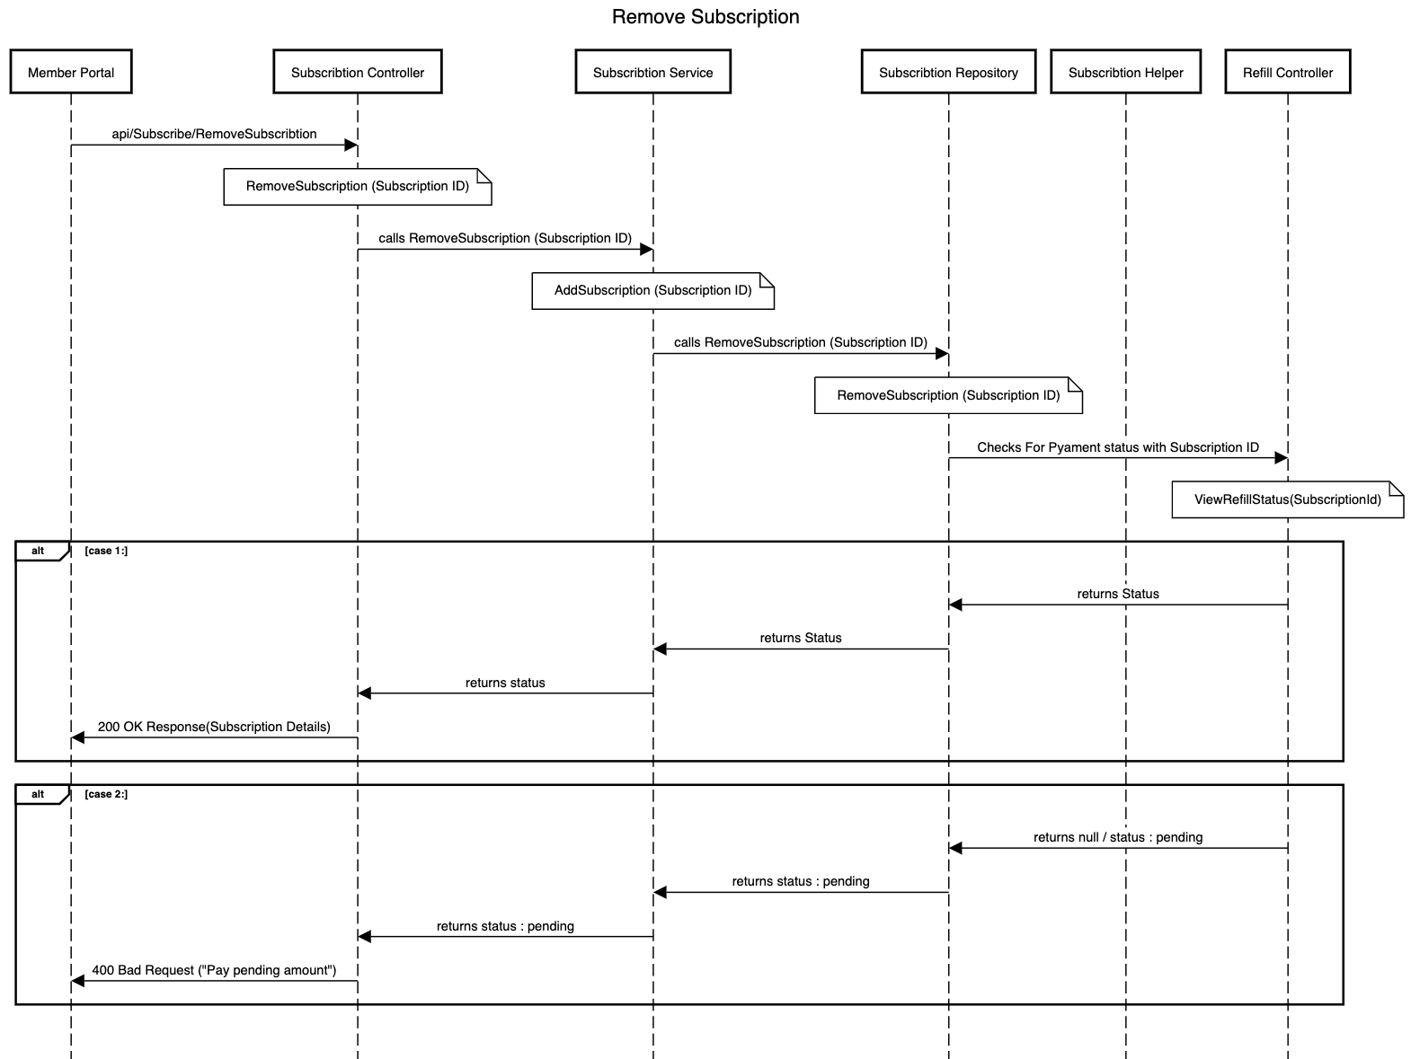

Slide 12
Refill Micro Service
Refill Micro service interacts with Drugs Micro service before taking an Adhoc Refill Order.
Interacts with Subscription Service to get the refill frequency subscribed to calculate the outstanding refill dues.
SUBSCRIPTION
MICROSERVICE
CONTROLLER
Calls
HELPER CLASS
Calls
SERVICE
REPOSITORY
Calls
Calls
DRUGS
MICROSERVICE

Slide 13
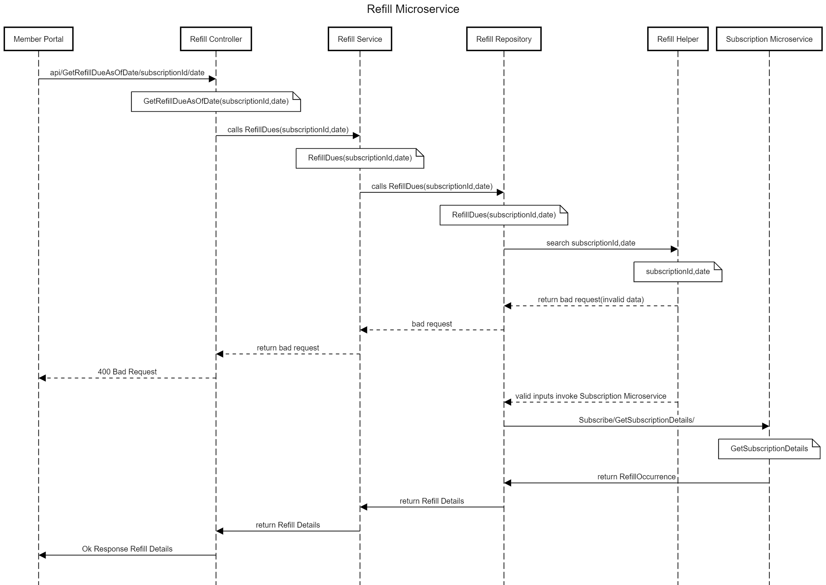

Slide 14
Authorization Micro Service
This micro service generate a token which get expired in a stipulated duration of
20 minute.
Token is generated using JWT package methods.
After token generation one will get authorization to access other services.
CONTROLLER
Calls
HELPER CLASS
SERVICE
REPOSITORY
Calls

Slide 15
LOGIN
PAGE
MEMBER PORTAL
Logout or session expired
SUBSCRIPTION
Token
Valid username and password
Logout or session expired
CLIENT
Token
REFILL
Token Generated
Back to login again
Token
DRUGS
Logout or session expired

Slide 16
MEMBER PORTAL
Member Portal allows a member to Login. Once successfully logged in, the member do the following operations:
Subscribe / Unsubscribe a Prescription for Refill Orders.
View Drugs that are supported.
View Refill Status.
View Refills that are due for the member.
Request an Adhoc Refill.

Slide 17
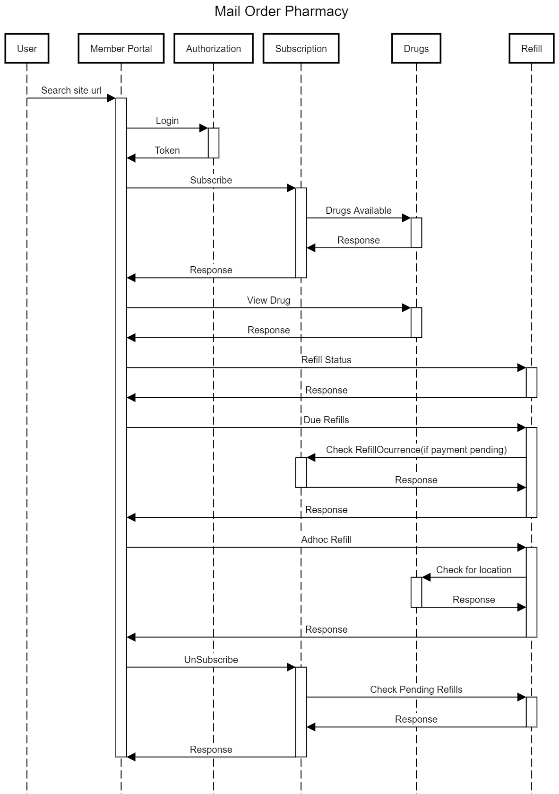

Slide 18
UNIT TESTING
Unit Testing is a process through which the functionality of a small unit of software
(i.e., methods) is tested.
Tested each method of every micro service against valid and invalid inputs and observe the outputs.
We have make use of packages like NUnit , NUnit3TestAdapter , Moq .
Test Fixure : This attribute makes a class testable.
Setup Method :Define objects that are required in each unit test.

Slide 19
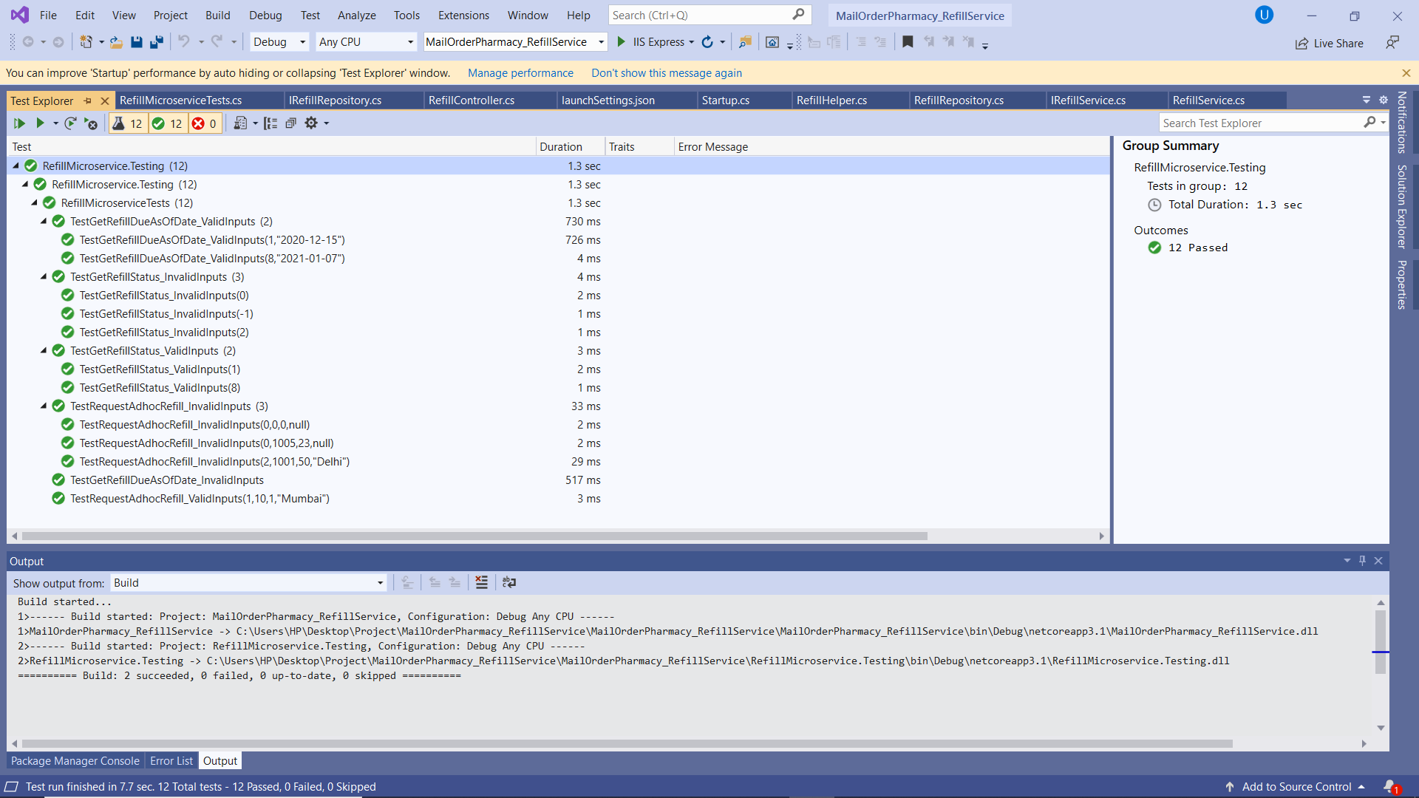

Slide 20
DEPLOYMENT PHASE

Slide 21
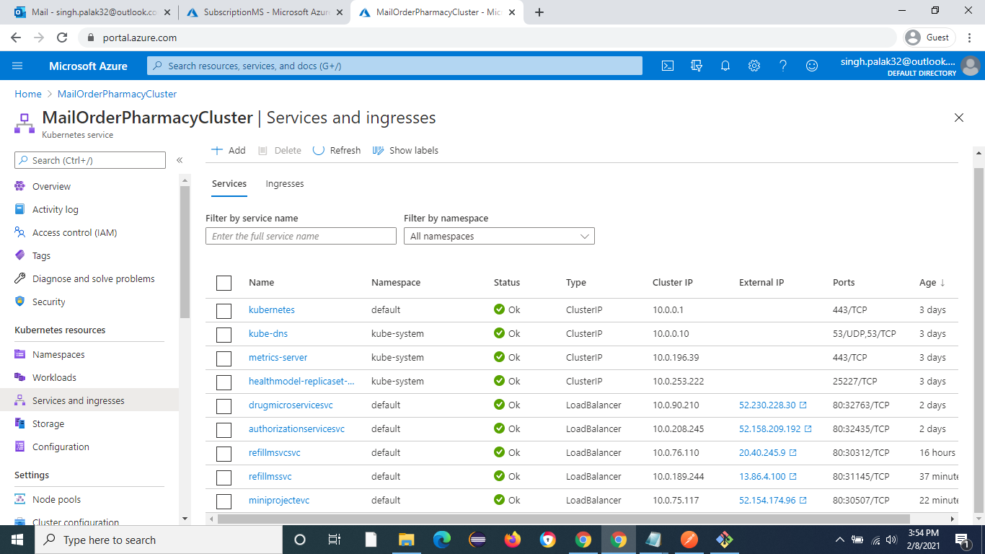

Slide 22
WORKING

Slide 23
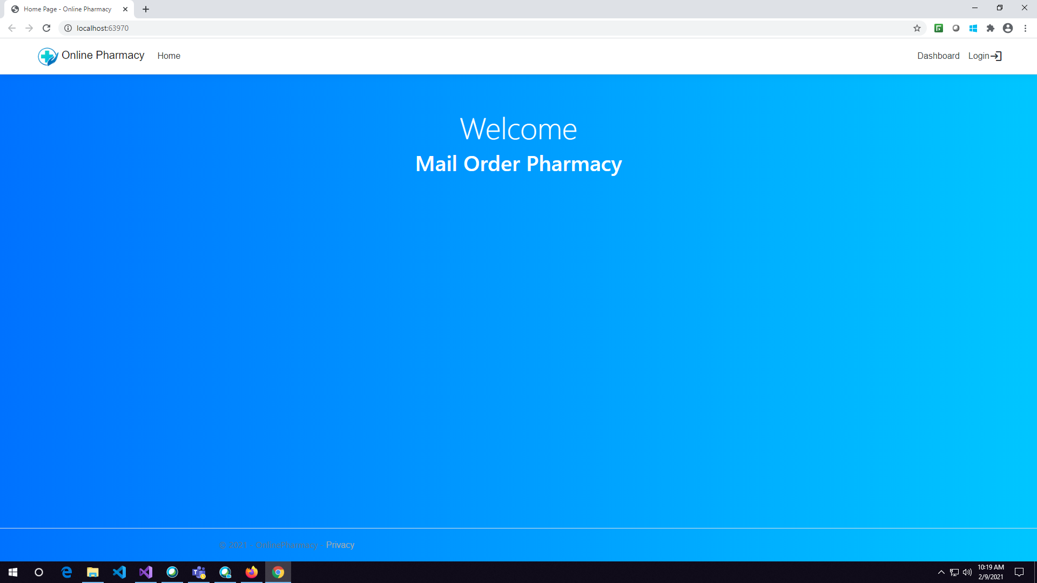

Slide 24
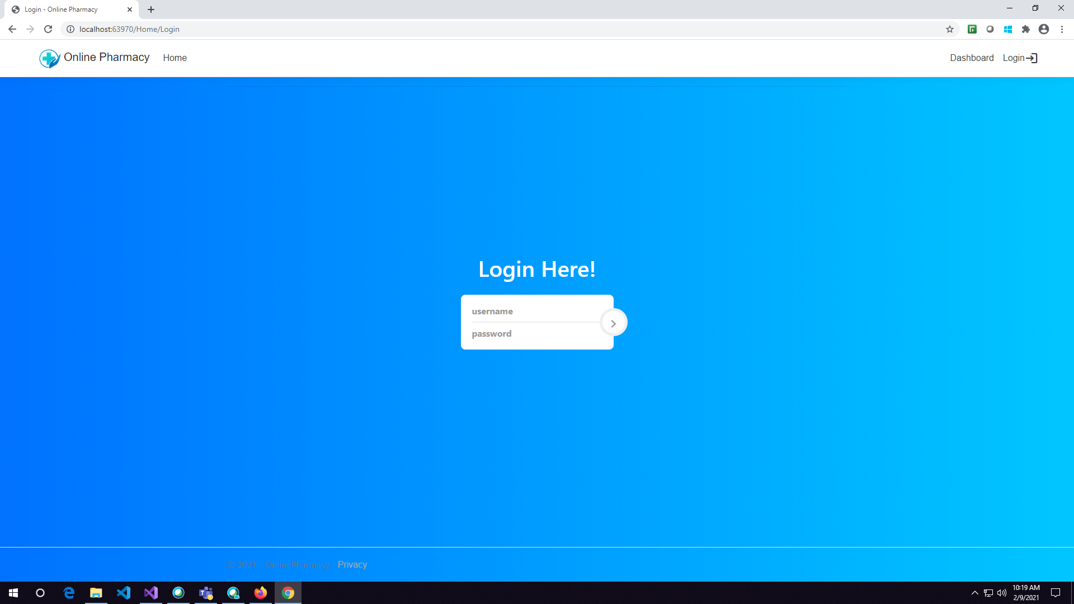

Slide 25
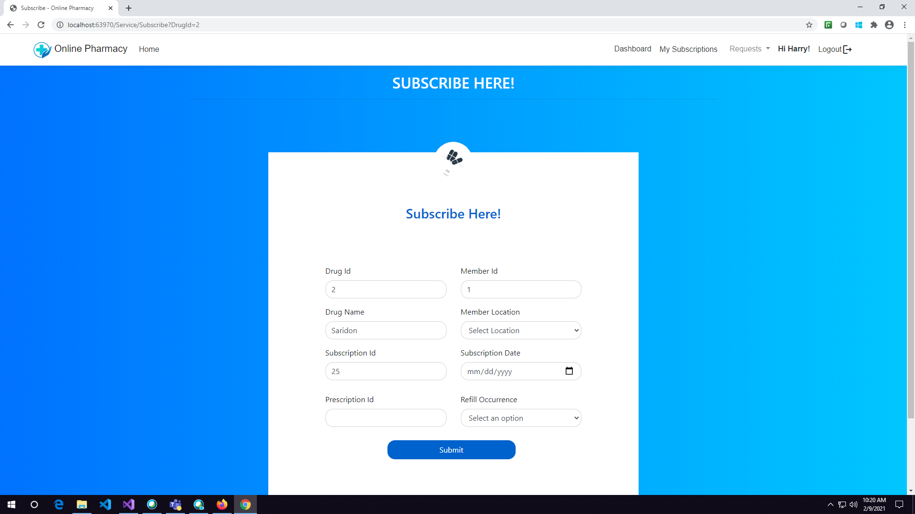

Slide 26
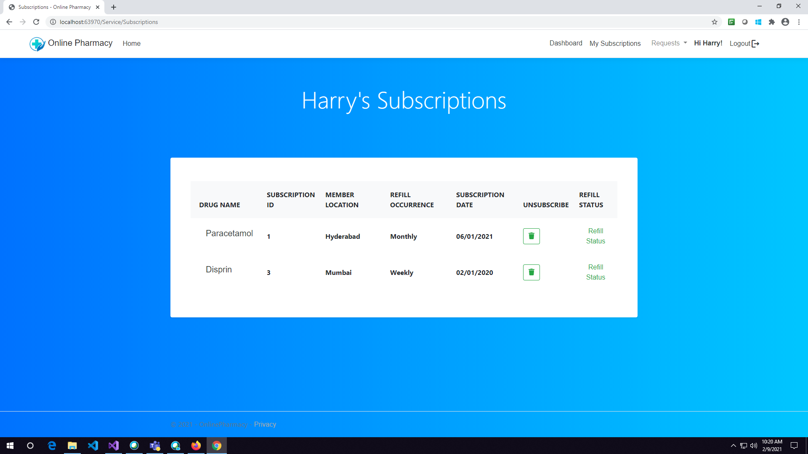

Slide 27
GROUP TAKEWAYS
In this Fullstack Development training program, I have gained strong knowledge and hands-on skills in:
C# Programming – Writing clean, efficient, and object-oriented code.
SQL Server – Designing databases, writing queries, stored procedures, and managing data effectively.
ASP.NET Core MVC – Building scalable web applications with MVC architecture.
Web API – Creating RESTful APIs for seamless communication between client and server.
React JS – Developing modern, interactive, and dynamic user interfaces.
"I had a great learning experience in fullstack development (ASP.NET & React). Our trainer shared not only in-depth subject knowledge but also practical insights that made the concepts clear and easy to understand. Grateful for the wonderful guidance and support throughout the sessions."

Slide 28
CONCLUSION
By doing this project we learnt how to study use case document , how to divide work among each other and present it in a better way.
It has improved our knowledge of Micro services , C# concepts, EF core, coding standards ,naming conventions, .Net Core Web API , MVC core and Nunit testing.
We also learn how to deploy micro services on cloud using Microsoft Azure .
How to integrate everything which we have learn during our training program in this project .

Slide 29
THANK YOU

